Slide 1
SAP REST API DEVELOPMENT
By
Rajkamal Kewlani

Slide 2

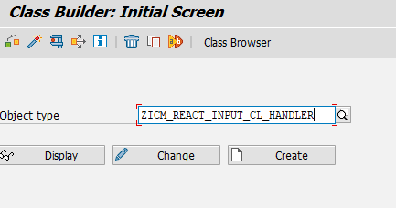
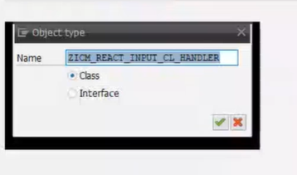
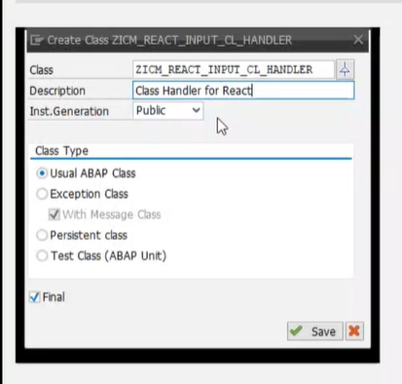
STEP 1 : Create REST Handler Class
Under TCODE SE24, create a new Class Handler
ZICM_REACT_INPUT_CL_HANDLER.
Choose the Class radio button and click on the Green tick to navigate to the next screen.
Write a suitable Description, then choose the Class Type as “Usual ABAP Class” and tick the checkbox “FINAL”. Click “Save” to navigate to next screen.

Slide 3
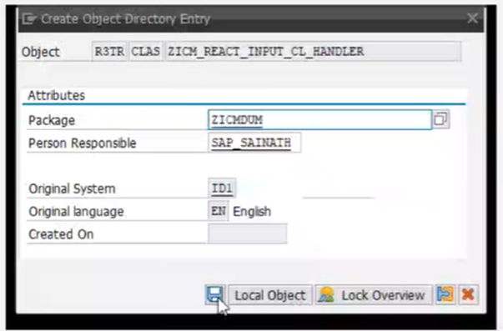
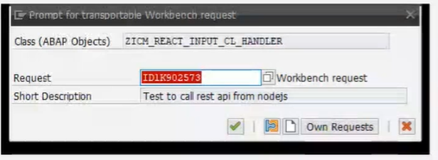
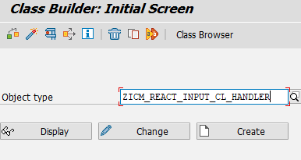
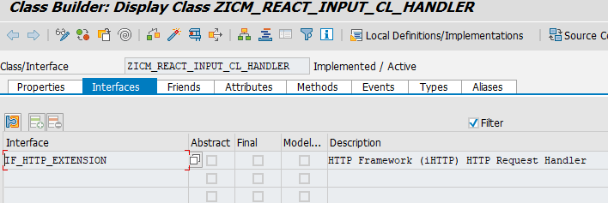
4. Choose a suitable package for the
Class Handler and create a new TR for
the same.
5. Click on “Change” button for the Class
Handler.
6. Under “Interfaces” tab of the Class
Handler, assign the Interface name as
“IF_HTTP_EXTENSION”.

Slide 4
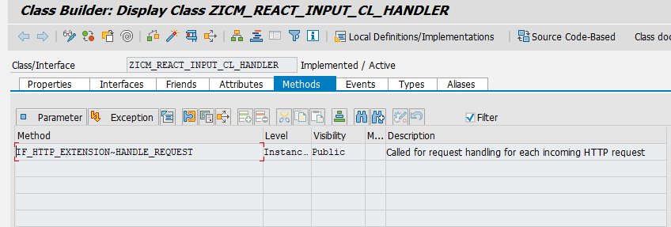
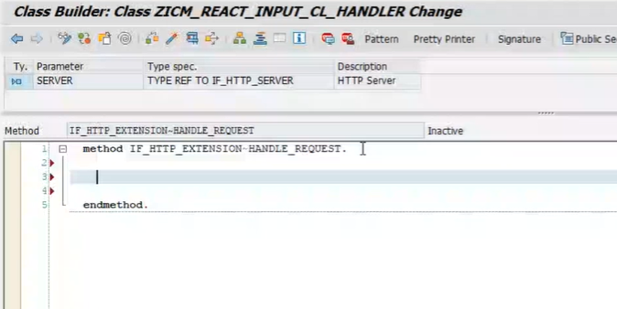
7. Click on the tab “Methods” and you’ll
see the a method has been added with
the name
IF_HTTP_EXTENSION~HANDLE_REQUEST
8. Double-click on the method
“HANDLE-REQUEST”, to start with
the redefinition of the method for the
REST API call.

Slide 5
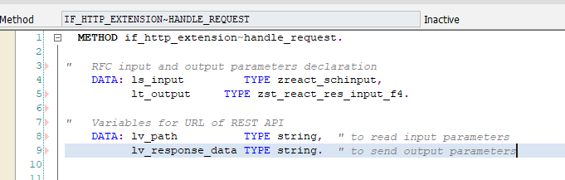
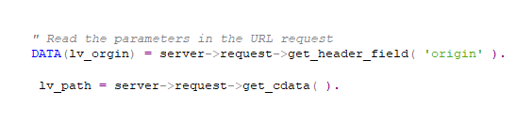
9. At first, the data declaration is done
for the RFC which needs to be called.
In this screenshot, the RFC input is a
structure “ls_input” and the RFC
output is a table type “lt_ouput”.
10. The next step is to declare string
variables for the URL of the REST API.
The “lv_path” string reads the input
parameters of the request and the
“lv_response_data” string stores
the output parameters to be sent
back to the calling application.
11. The next step is to read the JSON input
from the calling application.
The “lv_origin” parameter reads the
domain origin of the request. The
“lv_path” reads the body of the
request by the calling application,
in JSON format.

Slide 6
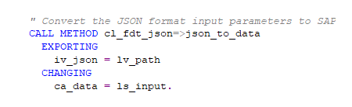
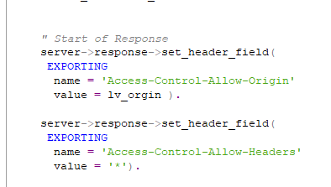
12. Now convert the JSON input to
ABAP, by calling the method
“CL_FDT_JSON=>JSON_TO_DATA “.
The converted input value is stored
in the input structure of the RFC that
needs to be called, later in the code.
13. Next, the response header is
populated with two imported Header
filed values for CORS policy (as shown
in the screenshot), which will allow
access of SAP REST API from the
client-end web browsers,
Note: Cross-Origin Resource Sharing (CORS) is a mechanism that uses additional HTTP headers to tell browsers to give a web application running at one origin, access to selected resources from a different origin.

Slide 7
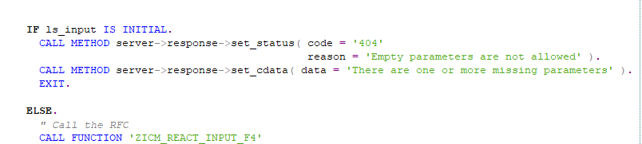
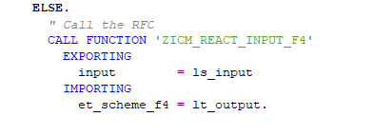
14. If the the input is initial, a status
code is set in the response
structure as code =“404” and
reason = “Empty parameters are
not allowed”.
The data filed in the response
structure is populated with a
suitable message such as
“There are one of more missing
parameters”. Then the “EXIT”
statement is written to send the
control back to the API calling
source.
15. For the ELSE part of the condition,
the RFC call is made and the
“ls_input” structure is passed to
the EXPORTING parameter. The
“lt_ouput” custom table stores the
IMPORTING parameter of the RFC.

Slide 8
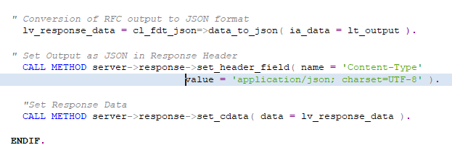
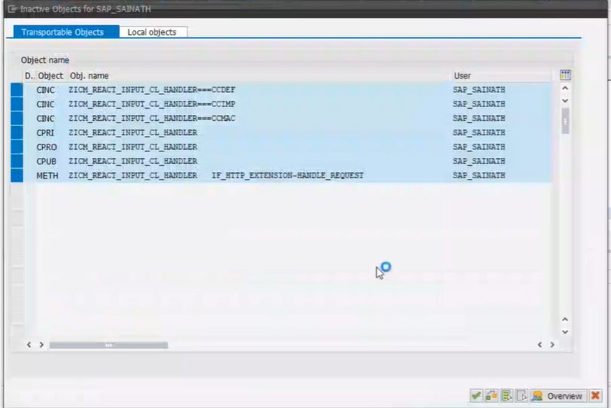
16. Next step in the Handler method
code, is to convert the RFC response
to JSON format.
17. Then the Response header field
“Content type” is set to display JSON
output with value =“application/json;
charset=UTF-8’.
18. The JSON response is set in the
Response structure, to be sent
through the REST API.
19. Next, Save and Activate the Handler
method. Select all the objects
displayed in the Inactive objects
screen and click the green tick.

Slide 9
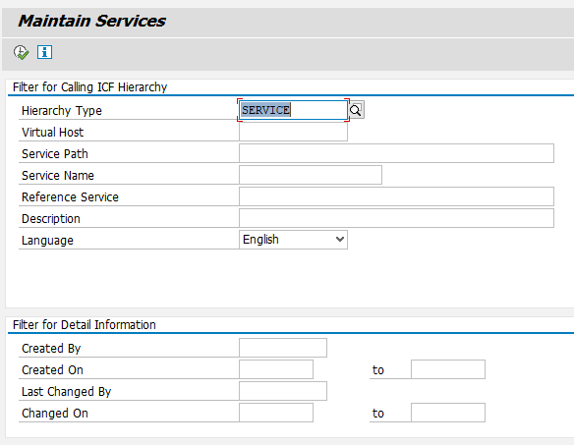

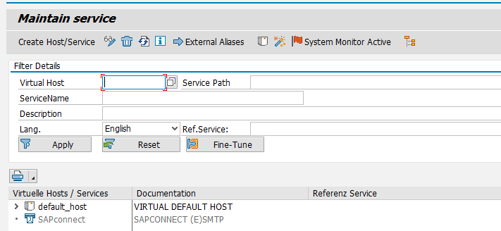
STEP 2 : Create ICF Node
Type in the TCODE /nSICF.
The following screen will be as shown in the second screenshot. Click on the Execute button.
The third screenshot shows the next screen that will appear. This screen is used to create the REST API service.
Note: The SAP transaction SICF is used to maintain services for HTTP communication in the SAP System, using the Internet Communication Manager (ICM) and the Internet Communication Framework (ICF).

Slide 10
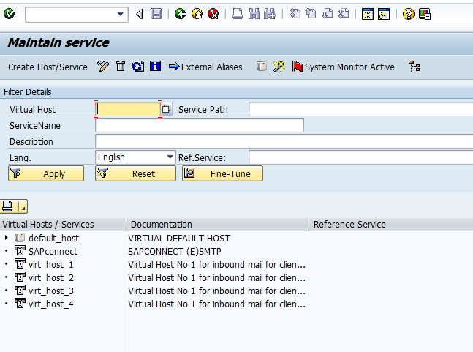
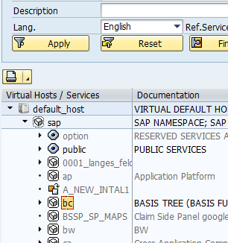
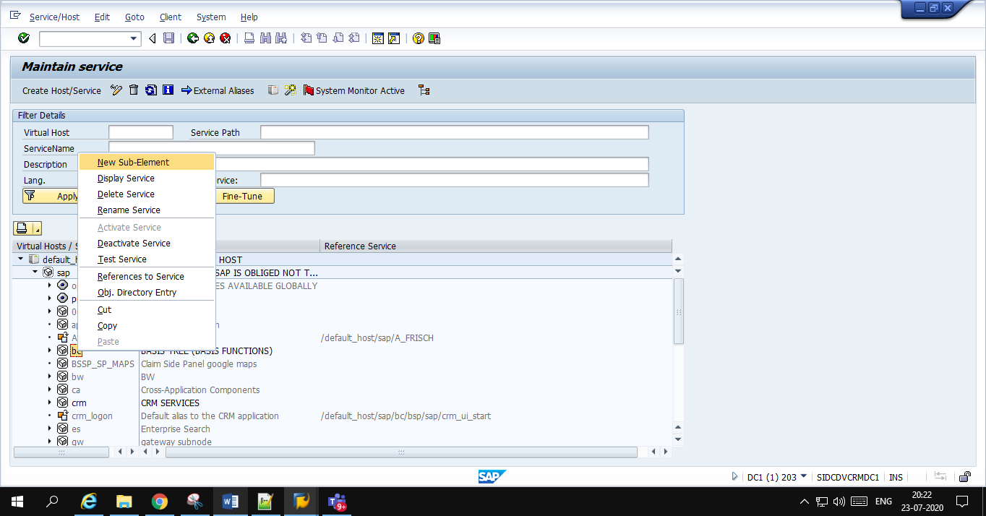
The REST API service has to be created under a particular node which will be found under the section “Virtual Hosts/Services”, in the second half of the screen.
Navigate through the path – “default_host->SAP->bc”
Right-click on host “bc” and select New Sub-Element and click on “New Sub-Element” as shown in the third screenshot.

Slide 11
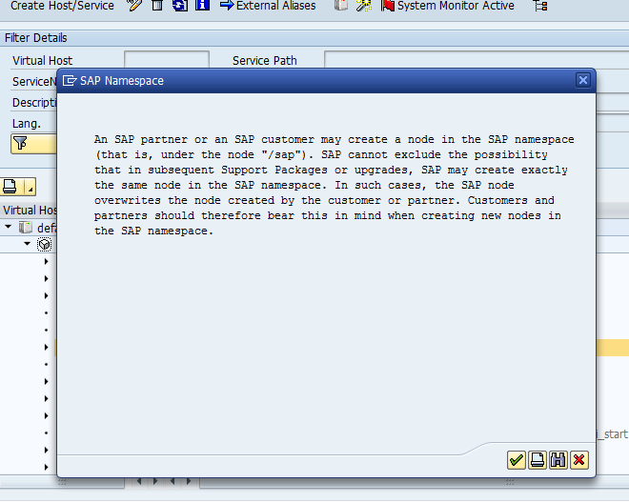
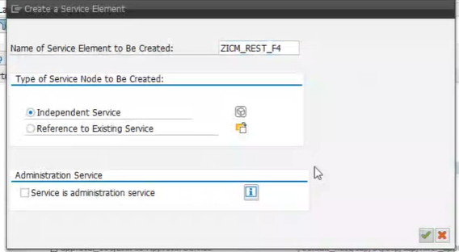
7. Click on the green tick for the
message which shows up on the
next screen.
8. On the next screen, give a suitable
name for the Service request element
that needs to created. Let the other
options on the screen remain the
same and click on the green tick.

Slide 12
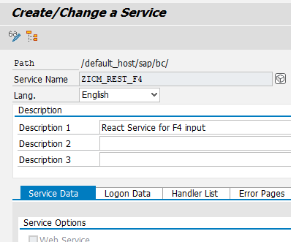
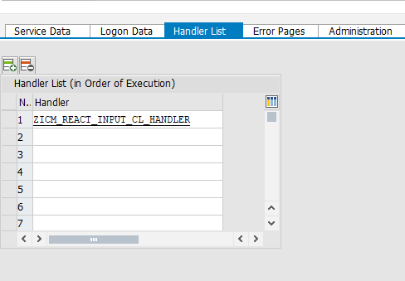
9. On the next screen, in Description 1
field, give a suitable description for
the service to be created.
10. Under the Handler List tab, assign
the Handler class created in the first
step of this process. The API service
requires this important parameter.

Slide 13
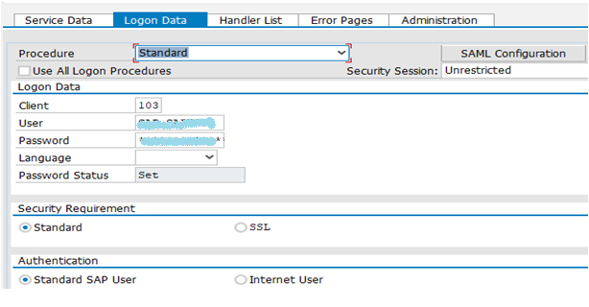
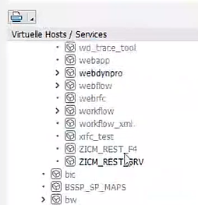
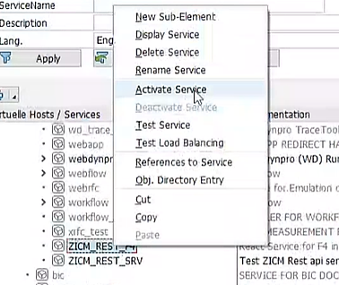
11. An optional input is to mention the
Logon Data, if a particular user is to
be restricted to Login through the
REST API.
12. Next, Click on the Save button.
Then click back button, to navigate
back to the previous screen showing
the service save under the
designated path.
13. The Service will appear greyed out.
Right click on the Service name and
choose the option “Activate Service”.

Slide 14
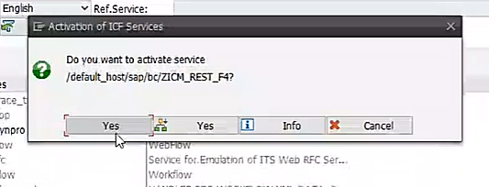
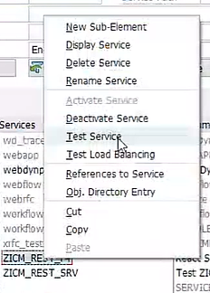
14. Click the first “Yes” option,
to activate the Service.
15. Next step is to get the REST UPI
URL for this Service created. For
that, again right click on the
service and this time click on
“Test Service”.

Slide 15
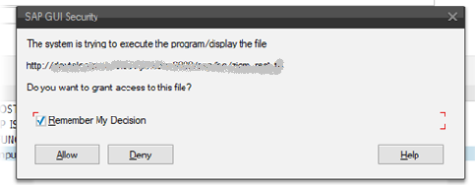
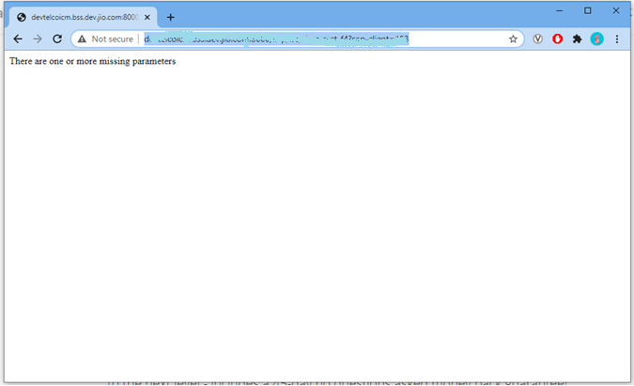
16. The required URL will be shown.
Kindly make a note of the REST
API URL, which then can be
shared with the open-source
developer. Then Click on
“Remember My Decision” and
then click the “Allow” button.
17. The browser opens up the URL as
seen in the screenshot. But here,
we do not get any response, since
no parameters were passed.
This is not the best practice to test
the REST API service. Therefore,
the POSTMAN app is used to test
the service.

Slide 16
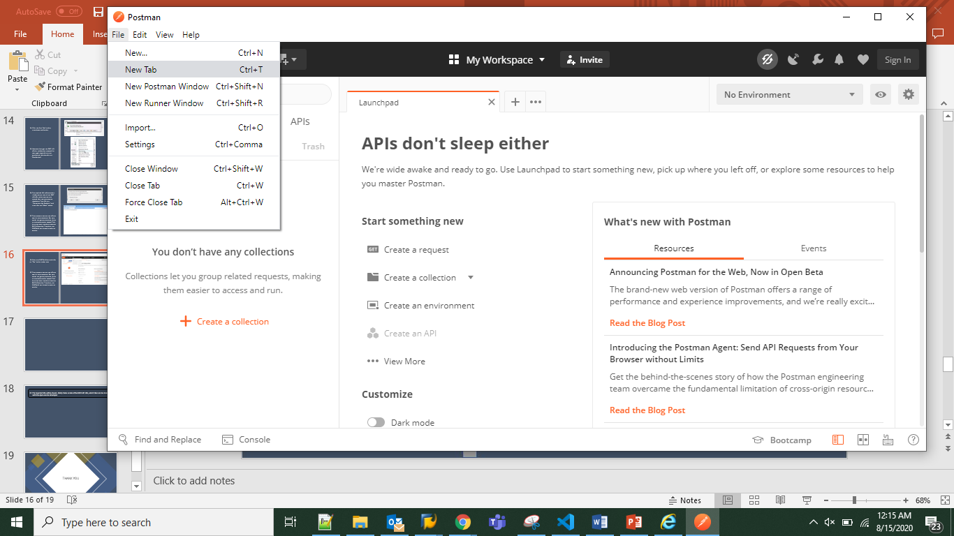
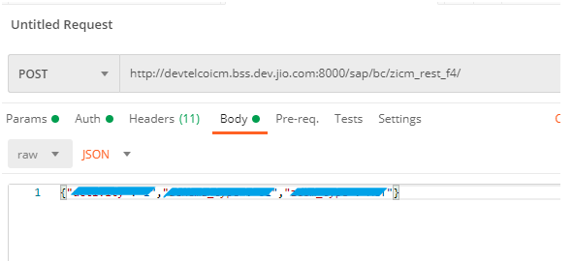
18. Open the POSTMAN app and click
on “ New Tab” option under the
File menu.
19. Choose the “POST” method and
paste the URL for testing and
paste the JSON input in the Body
section. Then click the “Send”
button to send the request to the
server.

Slide 17
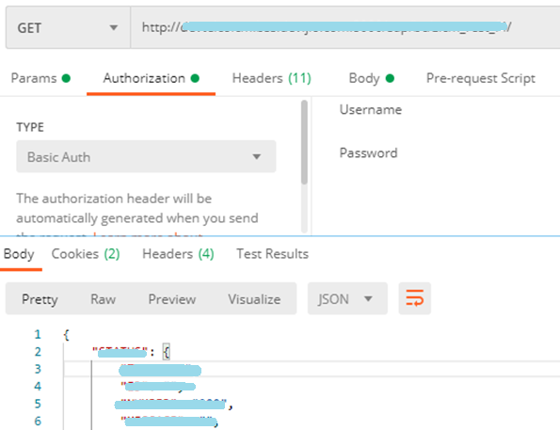
18. The required result get displayed in the Response field of the Postman app, as per the selected
output format.

Slide 18
THANK YOU

